Slide 1


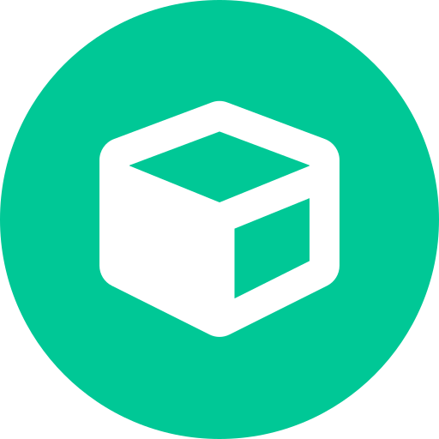

LECTURE 1 OF 2
Before You Touch Docker:
How Your Computer Actually Runs
Hardware · OS · Shell · Files & Permissions · Processes & fork() · Networking · Git
Shell
Files
Processes
Git
macOS · Terminal.app / zsh | Everything here also runs the same way inside a Docker container

Slide 2



ROADMAP
What We'll Build Up, Piece by Piece
1. The Machine
2. OS & Shell
3. Files & Permissions
CPU, RAM, disk, network card — what's physically there
Kernel, OS, shell, and how a typed command actually runs
Create/read/update/delete, users, read-write-execute
4. Processes & fork()
5. Networking
6. Git Essentials
What a process is, and how every process is born
IP addresses, ports, localhost, client ↔ server
Tracking changes to code, the way Dockerfiles live in repos
By the end: you'll read any Linux command with confidence — Lecture 2 goes straight into Docker.

Slide 3



PART 1 · HARDWARE
Meet the Machine Under the Hood
CPU — Processor
Executes instructions, one step at a time, blazingly fast
RAM — Memory
Fast, temporary workspace; wiped when power is off
Your MacBook
Every program you run — Terminal, Docker, VS Code — is really just these 4 physical resources, shared and scheduled.
Disk (SSD)
Slow, permanent storage — your files, apps, and OS live here
macOS runs on Apple Silicon (ARM) — Docker still gives you Linux containers via a lightweight Linux VM under the hood.
Network Card
Sends/receives data to other machines and the internet
DOCKER PREP · LECTURE 1
3 / 24

Slide 4


PART 1 · HARDWARE → SOFTWARE
From Hardware to Apps — The Layer Cake
Applications
closer to you
Chrome, Docker Desktop, VS Code, your code
Shell
zsh / bash — reads what you type, asks the kernel to act
Operating System (services)
File system, process scheduler, user accounts, networking stack
Kernel
The core that talks directly to hardware and enforces the rules
Hardware
CPU · RAM · Disk · Network card
closer to metal
DOCKER PREP · LECTURE 1
4 / 24

Slide 5
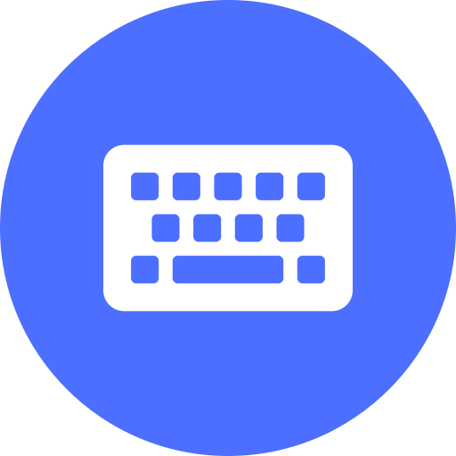

PART 2 · THE SHELL
The Shell — Your Window Into the OS
You
Shell (zsh)
Kernel
Hardware
Type a command in
Terminal.app
Reads, understands and
runs what you typed
Actually performs the
requested action
CPU / disk / network
do the real work
Shell vs. Terminal vs. Kernel — don't mix them up
Terminal.app
The window/app you open on macOS — just a display for text in and out.
Shell (zsh, default on macOS)
The program that parses your command and decides what to do — this is where $PATH, pipes | and variables live.
Kernel
The part of macOS/Linux that actually creates processes, opens files, and talks to hardware, on the shell's behalf.
DOCKER PREP · LECTURE 1
5 / 24

Slide 6
PART 2 · THE SHELL
Anatomy of a Command: From Enter to Output
Terminal.app
$ ls -la
1
Shell reads the line and splits it into tokens: ls and -la
2
Shell checks: is ls a built-in? No → it must be a program on disk
3
Shell searches every folder listed in $PATH until it finds /bin/ls
4
Shell calls fork() — the kernel clones the shell into a new child process
5
The child calls exec() — its memory is replaced with the ls program
6
Kernel schedules the new process on the CPU; it runs and prints output
7
Shell (the parent) was waiting — it now shows your prompt again
Steps 4–5 (fork + exec) are how every single program on Linux/macOS is ever started — including every process inside a Docker container.
DOCKER PREP · LECTURE 1
6 / 24

Slide 7
PART 3 · FILES & PERMISSIONS
Users & the Filesystem — Everything Lives in One Tree
Filesystem tree (starts at / — “root”)
Navigating it
/
$ pwd
the root of everything
print current folder
bin, usr/bin
core programs (ls, cat, docker…)
$ cd projects
etc
move into a folder
system-wide configuration files
$ cd ..
var
move up one level
logs, caches, changing data
$ cd ~
home
jump to your home folder
one folder per user
yourname
$ ls
your personal home directory (~)
list what's here
Desktop, Documents
$ ls -la
your everyday folders
list all, with details
projects/docker-course
where today's work will live
DOCKER PREP · LECTURE 1
7 / 24

Slide 8




PART 3 · FILES & PERMISSIONS
Create · Read · Update · Delete — Files & Folders
CREATE
READ
UPDATE
DELETE
mkdir demo
cat notes.txt
nano notes.txt
rm notes.txt
make a new folder
print the whole file
edit in a text editor
delete a file
touch notes.txt
less notes.txt
echo "hi" >> notes.txt
rm -r demo
make a new empty file
scroll through a file
append a line
delete a folder + contents
DOCKER PREP · LECTURE 1
8 / 24

Slide 9
PART 3 · FILES & PERMISSIONS
Read, Write, Execute — Decoding ls -l
$ ls -l script.sh
-rwxr-xr-- 1 gaurav staff 220 Sep 20 19:40 script.sh
-
rwx
r-x
r--
file type
(- file, d folder)
OWNER can
read, write, execute
GROUP can
read, execute (not write)
OTHERS can
only read
r = read (4) w = write (2) x = execute (1) → add them up per group to get the numeric mode, e.g. rwxr-xr-- = 754
Every file has exactly one owner and one group — “others” means everyone else on the machine.
For a folder, execute (x) means “can enter/cd into it”, not “can run it”.
DOCKER PREP · LECTURE 1
9 / 24

Slide 10
PART 3 · FILES & PERMISSIONS
Changing Permissions & Ownership
chmod — symbolic style
chmod — numeric style
chmod +x script.sh → add execute for everyone
chmod u+w file.txt → add write for the owner (u)
chmod go-rwx secret.txt → remove all access for group & others
chmod 755 script.sh → rwx for owner, r-x for group & others
chmod 644 notes.txt → rw- for owner, r-- for group & others
chmod 600 secret.txt → only the owner can read or write
before → after
$ ls -l deploy.sh
-rw-r--r-- 1 gaurav staff 0 Sep 20 19:40 deploy.sh
$ chmod +x deploy.sh # make it runnable
$ ls -l deploy.sh
-rwxr-xr-x 1 gaurav staff 0 Sep 20 19:40 deploy.sh
$ sudo chown gaurav:staff deploy.sh # change the owner:group
DOCKER PREP · LECTURE 1
10 / 24

Slide 11
PART 4 · PROCESSES
What Exactly Is a “Process”?
Terminal.app
A process = a program, currently running
$ ps aux | head -5
USER PID %CPU %MEM COMMAND
gaurav 501 0.2 1.4 /usr/bin/zsh
gaurav 742 4.1 3.0 node server.js
gaurav 818 0.8 2.1 com.docker.backend
$ top # live, refreshing view
$ echo $$ # PID of THIS shell
501
The moment you run a program (double-click an app, or type a command), the OS creates a process for it.
Every process gets a unique PID (Process ID) — a number the kernel uses to track it.
A process owns its own slice of memory, open files, and CPU time — separate from every other process.
One program can have many processes at once (open 3 Chrome tabs → several chrome processes).
This isolation — every process kept separate — is the exact idea Docker containers build on.
DOCKER PREP · LECTURE 1
11 / 24

Slide 12





PART 4 · PROCESSES
The Life of a Process
New
Ready
Running
Waiting
Terminated
step 1
step 2
step 3
step 4
step 5
New: the kernel is setting the process up (right after fork()).
Ready: waiting its turn for CPU time.
Running: actually executing on the CPU right now.
Waiting: paused — e.g. waiting on disk or network I/O.
Terminated: finished; the kernel reclaims its resources.
Zombie & orphan processes
A “zombie” has finished running but its exit status hasn't been read by its parent yet. An “orphan” is a child whose parent died first — it gets adopted by PID 1. Docker containers can accumulate zombies if PID 1 inside them never reaps children — one reason images use a tiny init process.
DOCKER PREP · LECTURE 1
12 / 24

Slide 13
PART 4 · PROCESSES — ANIMATION
How Every Process Is Born: fork() + exec()
FRAME 1 / 3
You type a command. Right now there is just ONE process: your shell.
zsh · PID 501
Your interactive shell,
waiting at the prompt
$ ls -la
_
DOCKER PREP · LECTURE 1
13 / 24

Slide 14
PART 4 · PROCESSES — ANIMATION
How Every Process Is Born: fork() + exec()
FRAME 2 / 3
fork() runs: the kernel clones the shell into an identical CHILD process.
zsh · PID 501
zsh · PID 502
fork()
Parent — keeps running,
waits for the child
Child — an exact copy
of the parent (PPID 501)
DOCKER PREP · LECTURE 1
14 / 24

Slide 15
PART 4 · PROCESSES — ANIMATION
How Every Process Is Born: fork() + exec()
FRAME 3 / 3
exec() runs inside the child: its memory is replaced by the ls program. It's no longer a shell copy — it IS ls now.
zsh · PID 501
ls · PID 502
exec()
Parent — still waiting
for the child to finish
Child ran exec("ls") —
now running the ls program
This fork + exec pair is exactly how “docker run” starts the process inside a new container.
DOCKER PREP · LECTURE 1
15 / 24

Slide 16

PART 4 · PROCESSES
Watching & Controlling Processes
ps aux
top / htop
list every running process, snapshot
live, auto-refreshing process monitor
kill 502
kill -9 502
ask a process (by PID) to stop nicely
force-kill immediately, no cleanup
command &
jobs / fg / bg
run in the background, get prompt back
list, resume in foreground/background
Ctrl+C sends an interrupt signal to the foreground process · Ctrl+Z pauses it and hands you back the prompt
DOCKER PREP · LECTURE 1
16 / 24

Slide 17
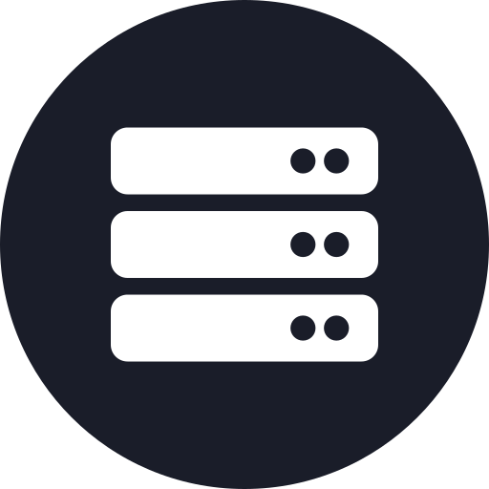

PART 5 · NETWORKING
Client, Server, and the Idea of a Port
request →
Client
Server
← response
Your browser, requesting
a page or API response
127.0.0.1 : 8080
IP address = the machine's postal address on the network (127.0.0.1 / “localhost” always means “this machine”).
Port = the specific door on that machine (1–65535) — one machine, many services, many ports (80 = web, 22 = SSH, 5432 = Postgres…).
This is exactly what Docker's -p 8080:80 does: maps a port on your Mac to a port inside a container.
DOCKER PREP · LECTURE 1
17 / 24

Slide 18




PART 5 · NETWORKING
Network Commands You'll Actually Use
ping google.com
curl -I localhost:8080
check reachability & round-trip latency
make an HTTP request from the terminal
ifconfig / ip addr
lsof -i :8080
show this machine's network interfaces & IP
see which process is using a port (macOS/Linux)
ssh user@host
netstat -an / ss -tulpn
open a secure shell on a remote machine
list active network connections
DOCKER PREP · LECTURE 1
18 / 24

Slide 19



PART 6 · GIT
Git — How Your Code Moves
Working Directory
Staging Area
Local Repository
Remote (GitHub)
Files you're editing
right now
Changes marked
for the next commit
Committed snapshots,
saved on your Mac
Shared copy, on
a server for your team
git add → git commit → git push (and git pull / git clone move the other way)
git pull brings new commits from the remote down into your local repo (opposite of push).
git clone copies an entire remote repository down to your machine for the first time.
A Dockerfile normally lives in this same Git repo — Lecture 2 builds an image straight from it.
DOCKER PREP · LECTURE 1
19 / 24

Slide 20
PART 6 · GIT
Git Command Cheat-Sheet
git init
start tracking a new project
git clone <url>
download an existing repo
git status
what's changed since last commit
git add file.js
stage a file for commit
git commit -m "msg"
save a snapshot with a message
git push
upload commits to the remote
git pull
download & merge remote commits
git branch feature-x
create a new branch
git checkout -b feature-x
create + switch to a branch
git log --oneline
view commit history
DOCKER PREP · LECTURE 1
20 / 24

Slide 21
RECAP
One Page, Everything We Covered
Files
Processes
ls · cd · mkdir · touch · cat · nano · cp · mv · rm · chmod · chown
ps aux · top · kill · kill -9 · jobs · fg / bg · fork() · exec()
Networking
Git
ping · curl · ifconfig / ip addr · lsof -i · ssh · ports & IPs
git init/clone · add · commit · push / pull · branch · log
DOCKER PREP · LECTURE 1 · RECAP
21 / 24

Slide 22

THE BRIDGE
Why All of This Matters the Moment We Open Docker
A Docker container is just an ordinary Linux process — made to feel like its own tiny computer.
fork() + exec()
Filesystem & permissions
“docker run” is literally the Docker daemon forking + exec-ing your program in a fenced-off environment.
Every image is a filesystem tree, just like /. Files inside still have owners, groups, and rwx bits.
Ports & networking
Git
-p 8080:80 maps a port on your Mac to a port inside the container's own private network.
Your Dockerfile lives in the repo you just learned to push and pull.
DOCKER PREP · LECTURE 1
22 / 24

Slide 23
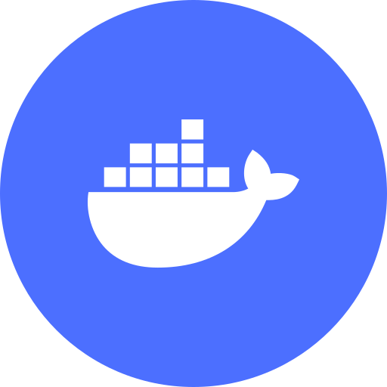

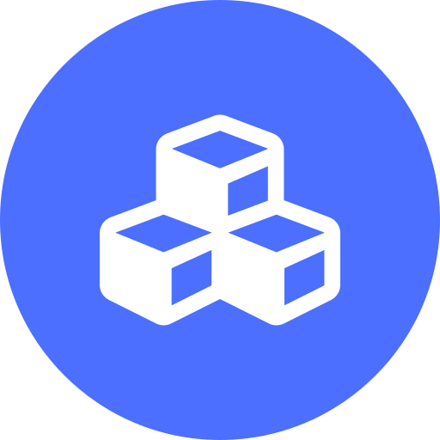
COMING UP
Lecture 2: Docker, Start to Finish
Install & Setup
Images vs. Containers
Writing a Dockerfile
Docker Desktop on macOS, docker --version, first checks
The blueprint vs. the running thing — pull, run, ps, stop
FROM, COPY, RUN, CMD — build your own image
Ports, Volumes & Networks
Docker Compose
Pushing to Docker Hub
-p, -v, and connecting multiple containers
Run a multi-container app with one command
Sharing an image with the world
Before Lecture 2: install Docker Desktop for Mac (Apple Silicon build) and make sure it launches.
DOCKER PREP · LECTURE 1 · NEXT UP
23 / 24

Slide 24

Questions?
we install Docker and run our first container together.
DOCKER PREP · LECTURE 1
24 / 24

